Slide 1
RoadResource.org
A COMPREHENSIVE RESOURCE FOR OPTIMIZING NETWORK MANAGEMENT

Slide 2
AGENDA
1
Background
2
Website Features
Treatment Toolbox | User Profile | Network Optimization

Slide 3

The Situation:
Demand is increasing for asphalt emulsions, preservation and recycling.
However, many city and county agencies are still unaware of benefits and best practices to successfully choose and apply these treatments.

Slide 4




Three Associations Join Together to Support the Industry at Large
FORMING THE PAVEMENT PRESERVATION & RECYCLING ALLIANCE
4
RoadResource.org
Notes:
The three organizations representing each branch of progressive pavement management join together to support the industry at large.
To create a voice that is more powerful, comprehensive, competitive and credible than any single association could be alone
Pavement Preservation and Recycling Alliance – for better roads today and stronger networks tomorrow.

Slide 5
Two Guiding Questions
1
2
How do we equip road owners & end users with tools to increase the successful use of pavement preservation and recycling?
How do we better disseminate research, success stories, and learning across all agencies, making information more accessible?
Notes:
The project was guided by two guiding questions:

Slide 6
Research & Collaboration
Retreats with ISSA, AEMA & ARRA leadership
Competitive exploration & Industry affiliations
International data survey
Input from over 45 agency and industry leaders
Interviews & beta-testing with agency-level users, pavement managers, DOTs, & roadway engineers
Page by page technical review from multiple committees
Notes:
These two questions spurred a year-long research project that included input from all levels of the industry.

Slide 7

RoadResource.org
7
Notes:
Culmination of that research project: A one stop shop digital resource for progressive pavement & network management.
Built to address the questions and concerns at the agency level to inform and train the successful use of Preservation, Recycling and Emulsions.

Slide 8
1
What treatment is right for my road?
Pavement Criteria Input
Photo Example Suggestions
Treatment Resource Center
Comprehensive Technical Menu
Regional Success Stories
Research and Performance
Spec Resources
SECTION 1
Treatment Toolbox
Information at the Treatment-level
2
WEBSITE FEATURES
PPRA User Account
SECTION 2
SECTION 3
Network Optimization
RoadResource.org
Notes:
The site is divided into two key sections– the first addresses concerns at the treatment level, and includes decision making tools, technical information and reference sources, success stories, current research and innovation features

Slide 9

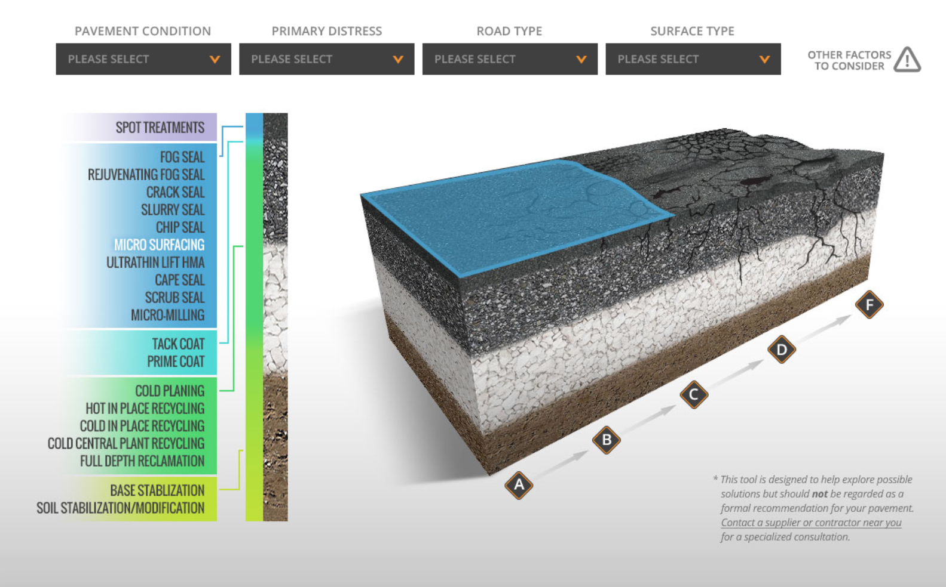
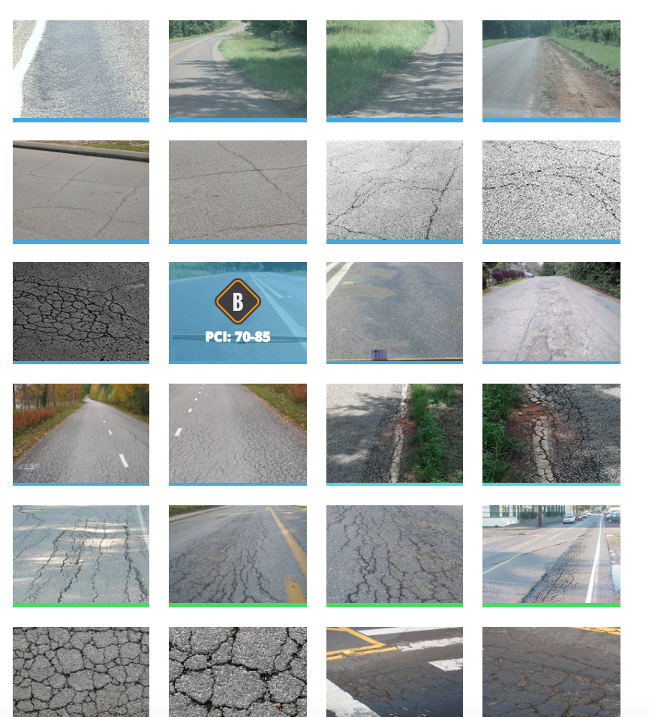
Which treatment is best for my road?
Input pavement criteria or select photos for treatment options
9
RoadResource.org
Notes:
Most road managers just want to know one thing: Which treatment should I use on my pavement?
This tool takes in information about your pavement and identifies possible solutions, using pavement condition, primary distress, road type and surface type, or comparing photos of other similar roads.
Note: This tool is NOT meant to be a diagnosis for your pavement, but to educate and demonstrate capabilities by treatment. Users are directed to “ask an expert” with these pages.

Slide 10
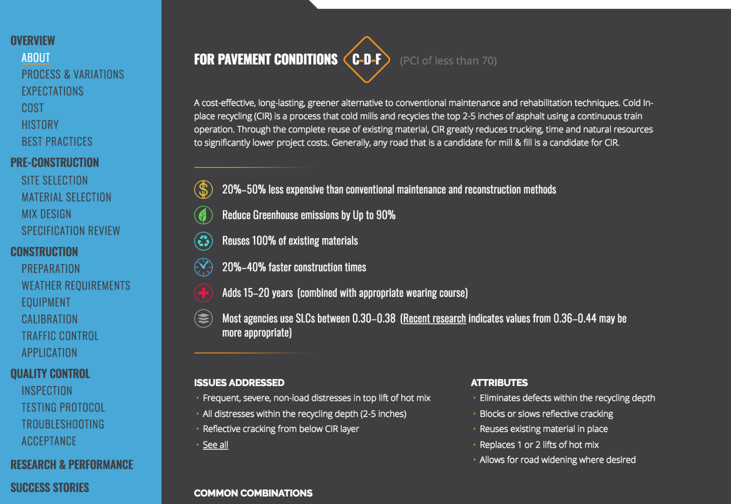
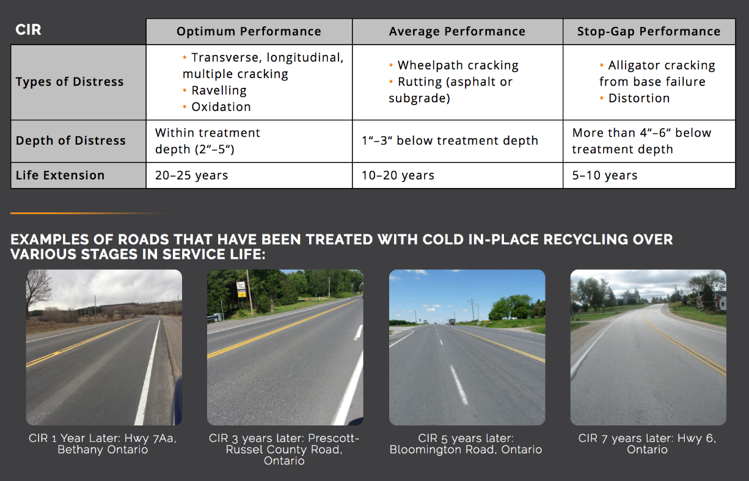


Treatment Resource Center
Ensure treatment success with comprehensive information on 18 treatments
10
RoadResource.org
Notes:
Treatment Resource Center
Designed to meet the needs of the average agency while accounting for the precise technical needs and expectations of the engineers. This section is robust, yet easy to understand. With information found in one place and written in plain English, More than 20 pages of information on each treatment within the same format. You can find exactly what you need, when you need it.
Seen here: Overview page, What to expect chart and photos (CIR 1 year, 3 years, 5 years, 7 years later) and best practices scattered throughout the site– make use of years of experience to fill in the gaps and make the process easy.

Slide 11
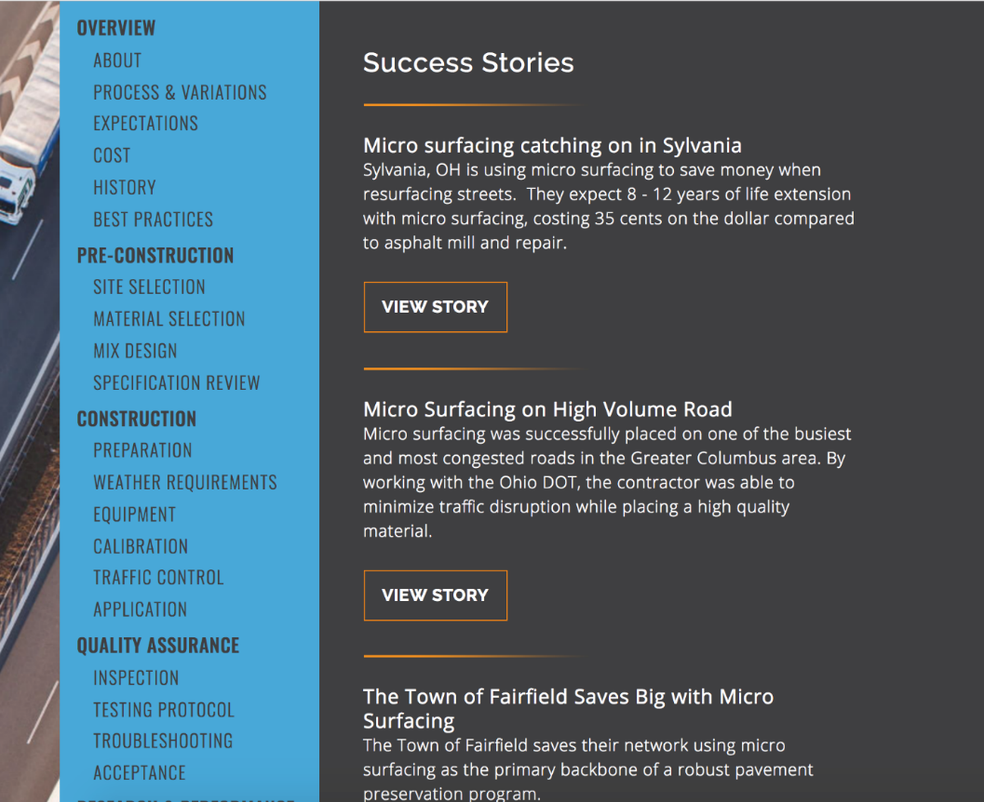
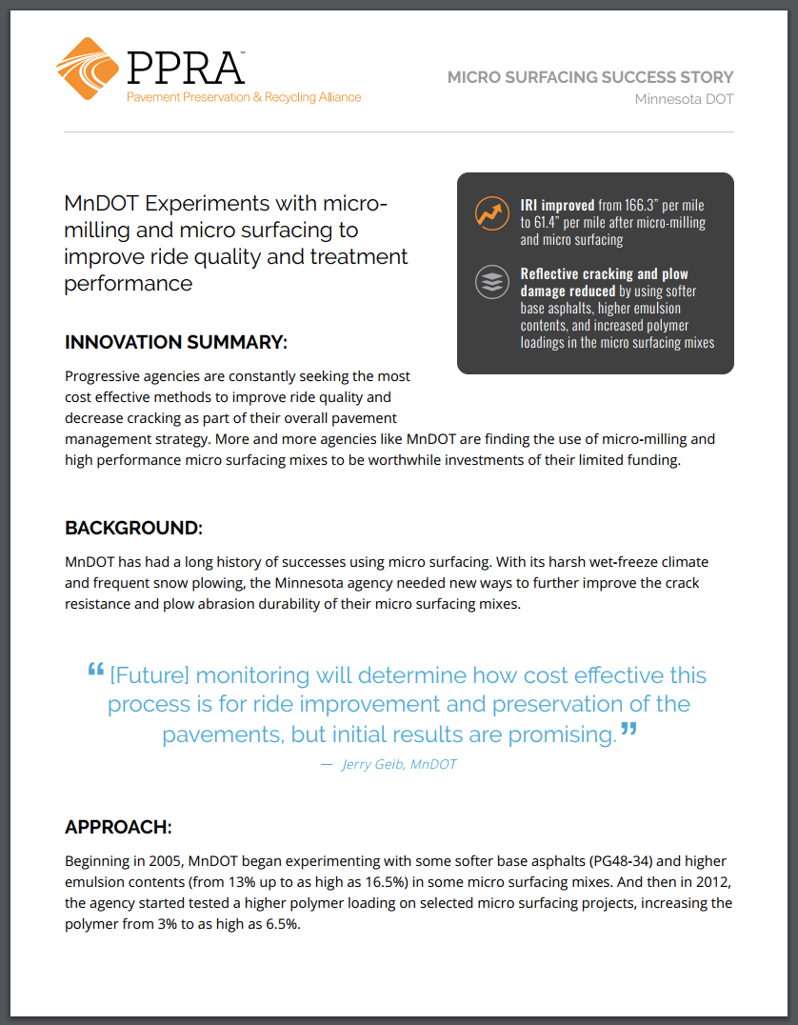
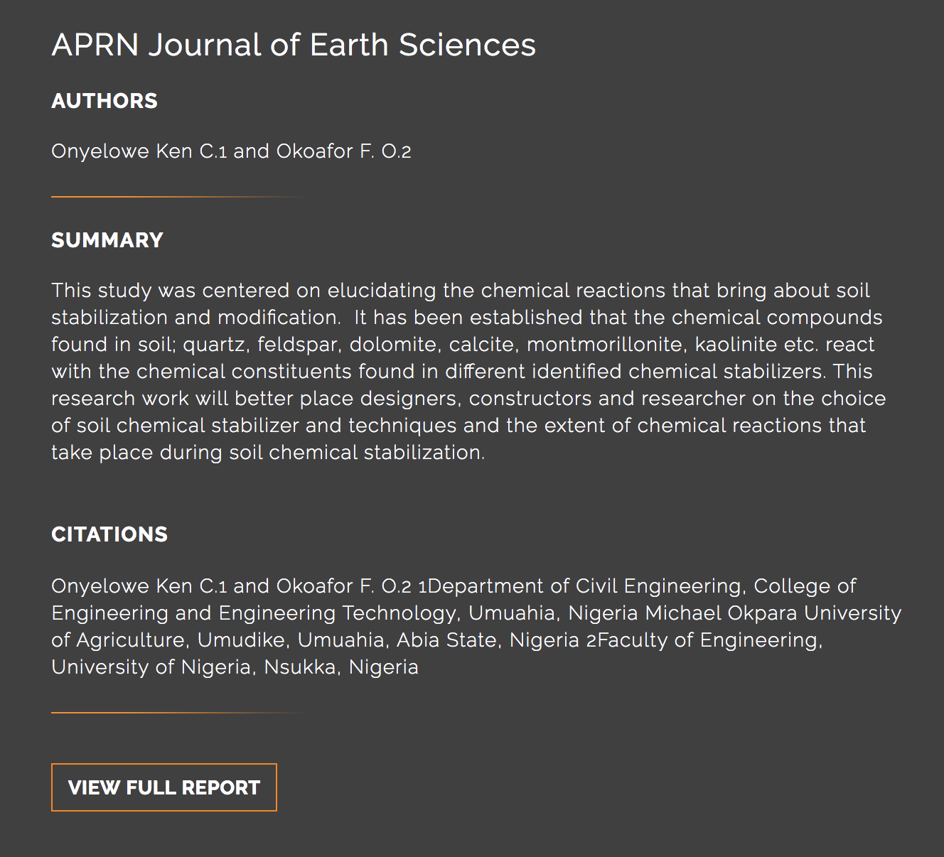
Success Stories & Research
Use, performance & best practices in your region
11
RoadResource.org
Notes:
When it comes to adopting a new treatment approach, decision-makers appreciate seeing someone in their region achieve success.
Success stories compiled within the Treatment Resource Center (with regional information and approaches), alongside Research papers and performance information– up to date, and modified with innovation in the industry.
Users are invited to submit their own success stories, by region, to help other users understand tips, tricks, and best practices.

Slide 12
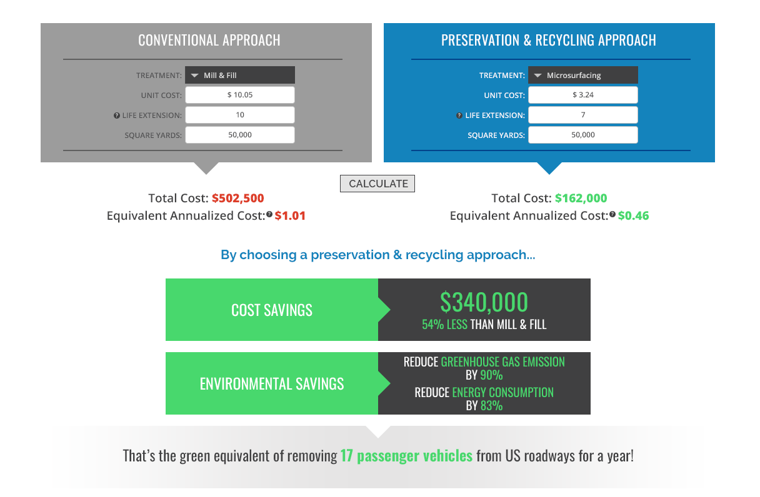
Compare Treatments
Project Cost & Environmental Benefits
NOTE ON COST:
Every calculator gives users the ability to use average life extension numbers and cost data from an internationally aggregated cost survey (US & CA) or input their own costs and life extension relevant to their region.
12
RoadResource.org
Notes:
Cost & Green Calculator
A treatment-level calculator that allows users to compare economic and environmental impact of one treatment over another.
Note: Across the site, data is auto-populated with figures and data from international cost survey and average life extension– We’ve also given users the ability to enter their own figures– making the information more relevant to your region/experience.

Slide 13
User Account Capabilities
Enter unit cost, life extension, and structural numbers from your area
Update units of measure for US or Canada
SECTION 1
Treatment Toolbox
WEBSITE FEATURES
PPRA User Account
SECTION 2
Tailor tools & calculators to your area
SECTION 3
Network Optimization
RoadResource.org

Slide 14
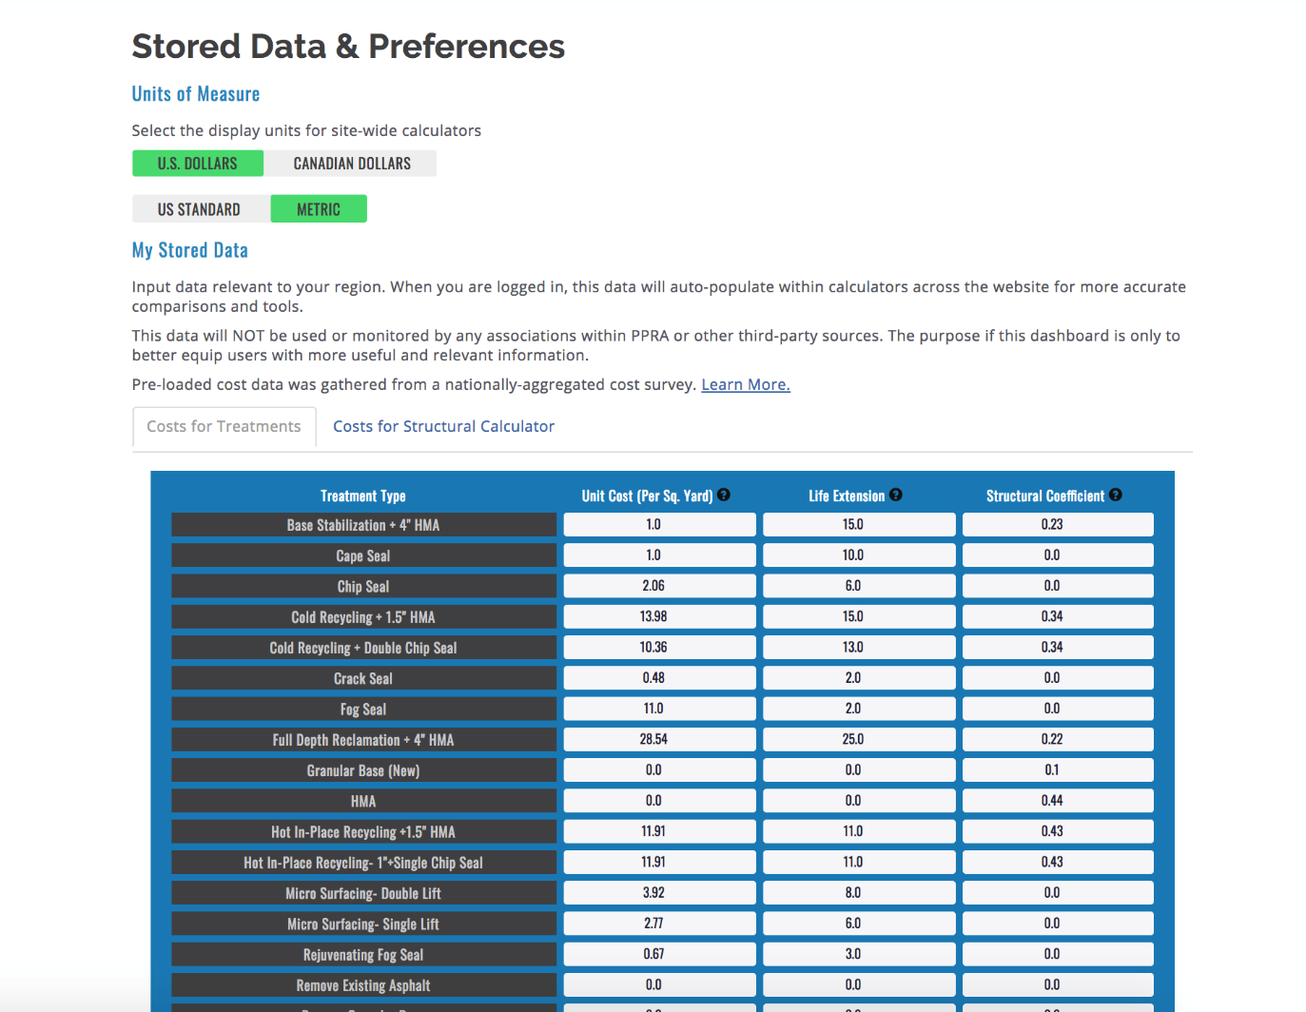
My PPRA Account
Input costs and life extension in your area to make the most of the site & tools
NOTE:
Change aggregate data into costs, life extension, and structural numbers relevant to you. Tools throughout the site automatically re-populate with your data every time you log in.
14
RoadResource.org

Slide 15
Calculators & Concepts
Network How-To
Equivalent Annualized Cost
Life Cycle Cost
Remaining Service Life
Cost-Benefit Value
SECTION 1
Treatment Toolbox
WEBSITE FEATURES
PPRA User Account
SECTION 2
SECTION 3
Network Optimization
Information at the Network Level
RoadResource.org
Notes:
Section 2
Our big takeaway from the research process: The best way to improve a network and make resources go farther is through the use of preservation and recycling treatments which save money and prolong road life. The treatment and the network are intrinsically connected–
This section teaches network-level concepts, and gives users the calculators to apply and explore with their own networks & roads.

Slide 16
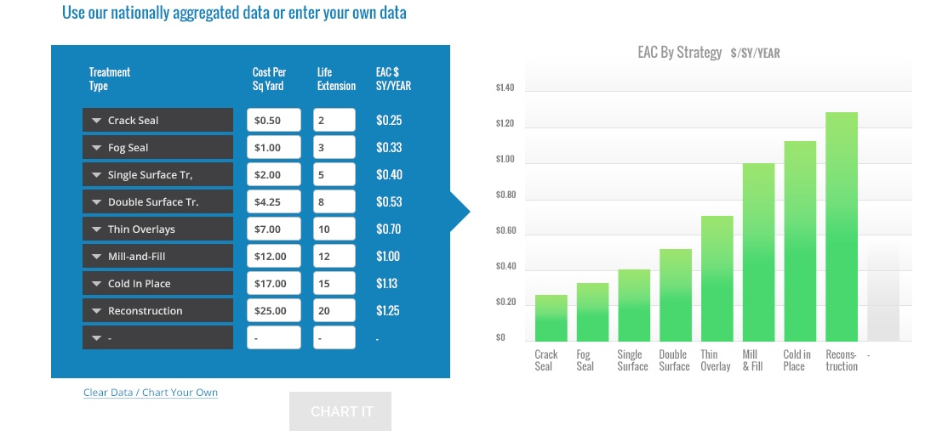
Equivalent Annualized Cost
Compare treatment cost based on Life Extension
16
RoadResource.org
Notes:
Equivalent Annualized Cost Calculator
The first comparison tool, and most basic foundation for network consideration– which treatment will go the furthest for the cost?
Compares unit cost per year of life extension. An “apples to apples” understanding of competitive treatments.

Slide 17
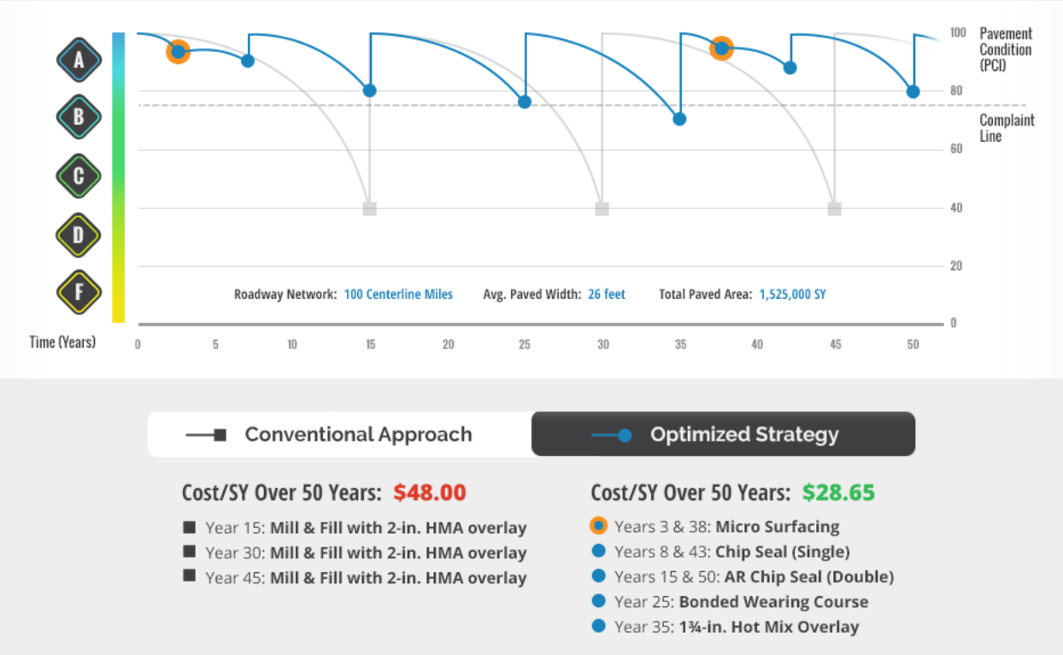
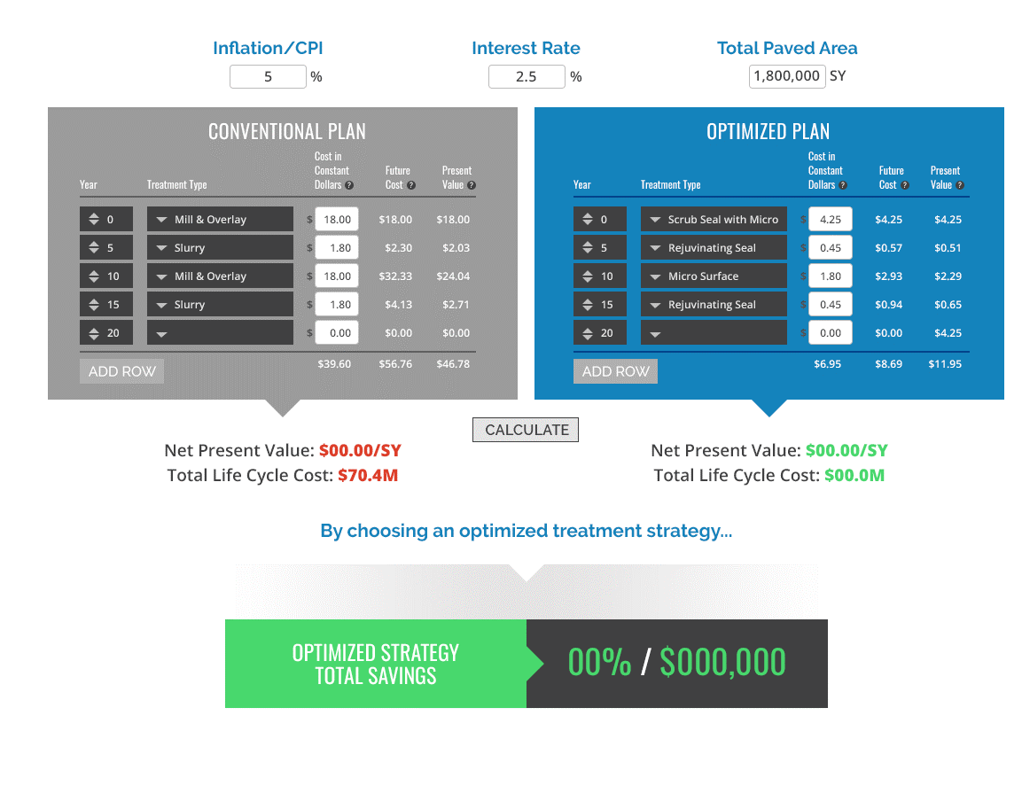

Life Cycle Cost Calculator
Save big over the life of your pavement with progressive maintenance
17
RoadResource.org
Notes:
Life Cycle Cost Calculator
Teaching concept– Not designed to replace a PMS, but to support network thinking. The lifecycle calculator lets you design a road treatment plan, demonstrating the ability to revive and preserve a road for 50 years or more.
In Understanding the time-value of money, users can see that a dollar today is worth much more 15 years down the line. It pays to invest in your roads upfront.

Slide 18
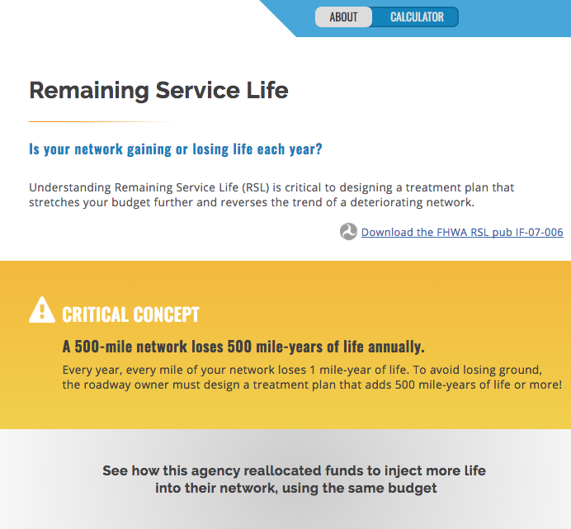
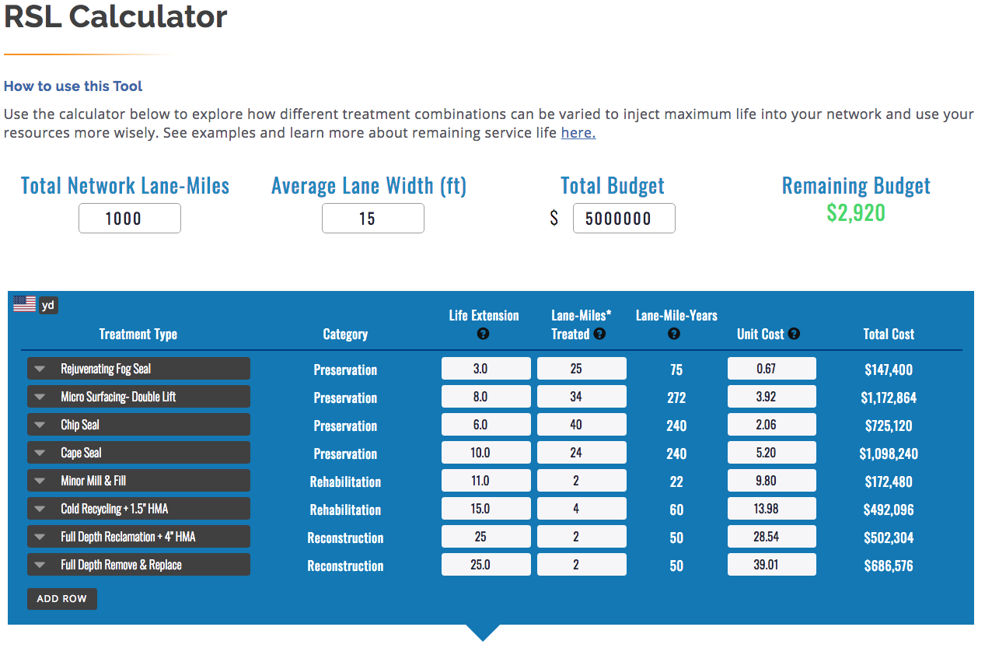
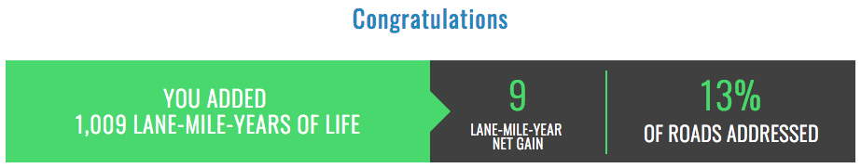
Remaining Service Life
How much life is your network gaining or losing each year?
18
RoadResource.org
Notes:
Remaining Service Life
looks at the health of your network through your yearly treatment plan.
A critical concept for network management: each mile of road has a life expectancy. Every year, each mile of road within your network uses one mile-year of life. That means that your network has a limited number of mile-years to live. RSL helps you understand the effectiveness of your annual treatment plan, to determine if that plan will add or subtract life from your network, and identify tweaks you can make to make overall, incremental “network-level” gains.

Slide 19
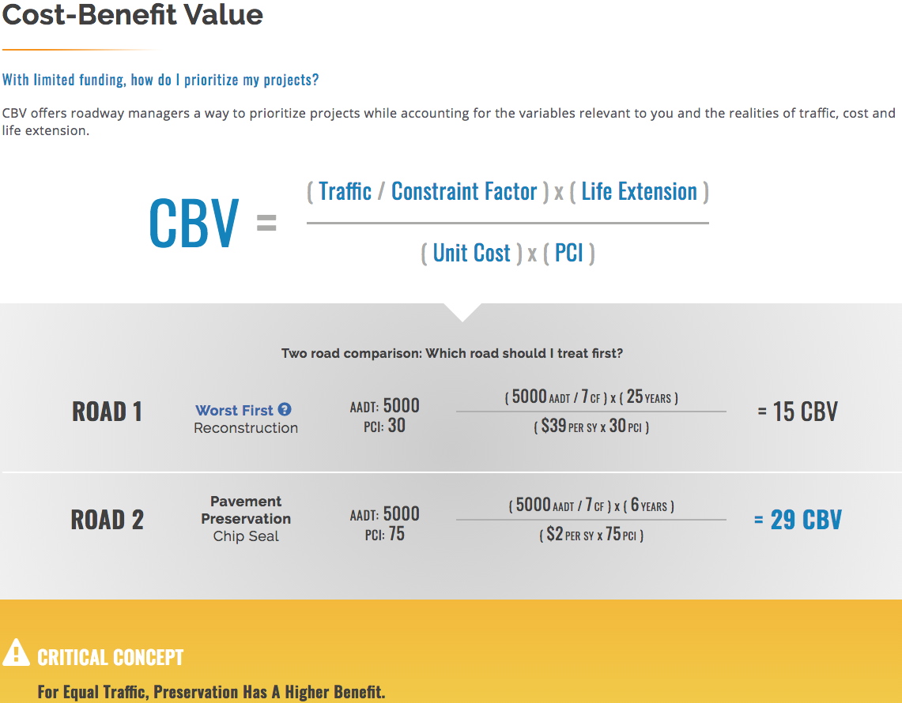
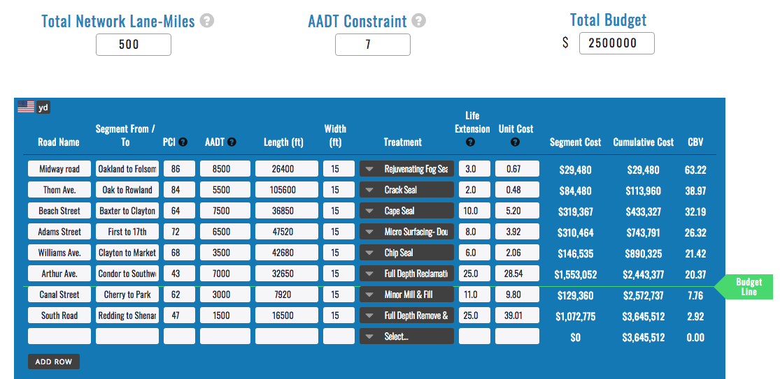
Cost-Benefit Value
Which projects will give the “biggest bang for the buck?”
19
RoadResource.org
Notes:
Cost-Benefit-Value
This formula prioritizes road projects. “Great, I know I should be treating all of my roads, every year, but that’s not realistic in any way.– Which projects will give me the biggest bang for the buck?? How do I prioritize limited resources?”
CBV takes into account project size, overall cost, Average Annual Daily Traffic, and your annual budget --- each project is evaluated using a CBV figure to give you quantifiable comparison factors between projects.
Allows users to see “No, this project isn’t very important for this year. I’ll address several others instead, and take a different approach next year”

Slide 20

Subscribe to the Road Resource Newsletter
Stay up-to-date with the latest in industry news, innovation and research

Slide 21



Like and Follow PPRA on Social Media
21
RoadResource.org

Slide 22



FOR MORE INFORMATION
Sales Person Name
Company
000-000-000
email@emailaddress.com
For Association Information

Slide 23


Visit the new RoadResource.org

